Slide 1
RECIPROCATING
PUMPS
Amiraj College of Engg. And Technology
PRESENTED BY,
SOLANKI SAMIR D.
CIVIL- SEM1
ENROLLMENT NO = 131080106063

Slide 2
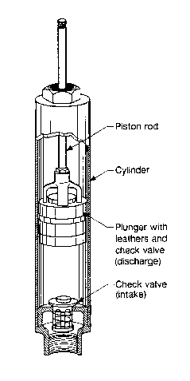
Family tree
Positive Displacement Pump
Linear Type
Reciprocating Type
Rotary Type
Piston Pump
Diaphragm Pump
Causes a fluid to move by trapping a fixed amount of it and then forcing (displacing) that trapped volume into the discharge pipe.
Also known as “Constant Flow Machines”

Slide 3
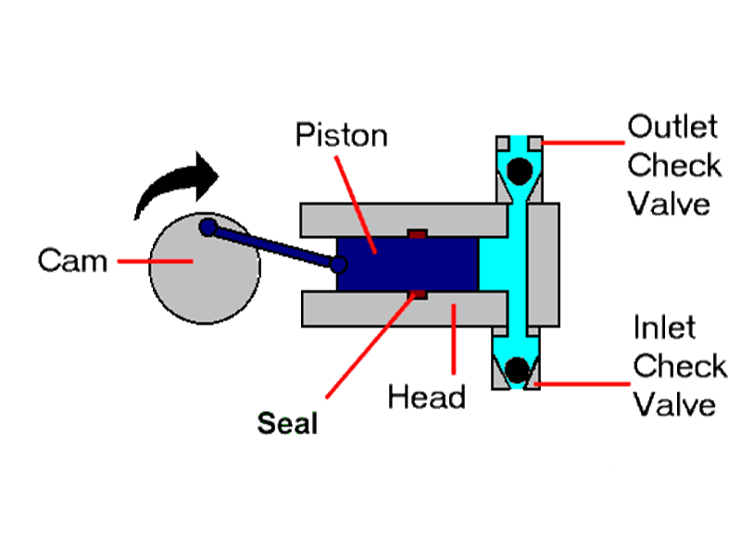
Operating principle
Pushing of liquid by a piston that executes a reciprocating motion in a closed fitting cylinder.
Crankshaft-connecting rod mechanism.
Conversion of rotary to reciprocating motion.
Entry and exit of fluid.

Slide 4
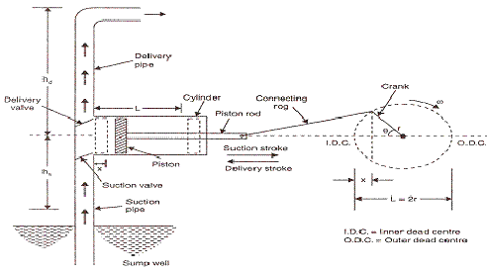
Working
Cylinder.
Suction Pipe.
Delivery Pipe.
Suction valve.
Delivery Valve.

Slide 5
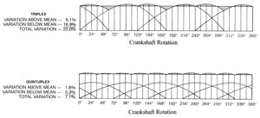
characteristics
Triplex
No generation of head.
Because of the conversion of rotation to linear motion, flow varies within each pump revolution.
Flow variation for the triplex reciprocating is 23%.
Flow variation for the quintuplex pump is 7.1%.
Crank-shaft Rotation
Quintuplex
Crank-shaft Rotation

Slide 6
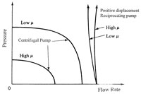
Effect of viscosity
Reciprocating Pump
Pressure
Provides a nearly constant flow rate over a wider range of pressure.
Fluid viscosity has little effect on the flow rate as the pressure increases.
Centrifugal Pump
Flow Rate

Slide 7
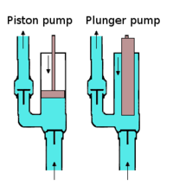
PISTON/plunger PUMP
They are reciprocating pumps that use a plunger or piston to move media through a cylindrical chamber.
It is actuated by a steam powered, pneumatic, hydraulic, or electric drive.
Other names are well service pumps, high pressure pumps, or high viscosity pumps.
Cylindrical mechanism to create a reciprocating motion along an axis, which then builds pressure in a cylinder or working barrel to force gas or fluid through the pump. The pressure in the chamber actuates the valves at both the suction and discharge points.
The volume of the fluid discharged is equal to the area of the plunger or piston, multiplied by its stroke length.

Slide 8
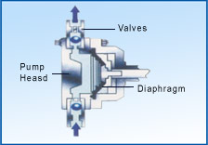
DIAPHRAGM PUMP
A diaphragm pump is a pump that uses a combination of the reciprocating action of a rubber, thermoplastic or teflon diaphragm and suitable non-return check valves to pump a fluid.
Has been developed for handling corrosive liquids and those containing suspensions of abrasive solids.
In one section a piston or plunger operates in a cylinder in which a non-corrosive fluid is displaced..
The movement of the fluid is transmitted by means of flexible diaphragm to the liquid to be pumped. The only moving parts of the pump that are in contact with the liquid are the valves, and these can be specially designed to handle the material.
In some cases the movement of the diaphragm is produced by direct mechanical action, or the diaphragm may be air actuated.

Slide 9
Characteristics of
diaphragm pump
Suitable for discharge pressure up to 1,200 bar have .
Good dry running characteristics.
Are low-shear pumps.
Can be used to make artificial hearts.
Are used to make air pumps for the filters on small fish tanks.
Can be up to 97% efficient.
Can handle highly viscous liquids.
Are available for industrial, chemical and hygienic applications.

Slide 10
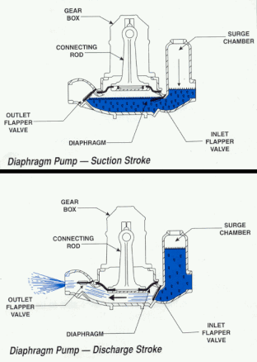
Working of diaphragm pump
A vacuum is created inside the pump casing each time the diaphragm is raised.
This opens the inlet valve and seals the discharge valve allowing water and air to enter the pump.
When the diaphragm is lowered the resulting pressure seals the inlet and opens the outlet valve purging the pump housing of water and air.
Unlike centrifugal designs the water inside the casing is positively displaced and no recirculation occurs.

Slide 11
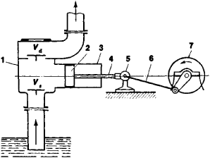
Pumping power
ΔP: Change in total pressure between
the inlet and outlet.
Q: Discharge of the pump.
η: Efficiency.
Power=(Δp*Q)/η
Q=(ALN)/60.
Q: – Discharge of the pump, m³/sec.
A: – Cross-section of piston or cylinder, m².
L: – length of stroke in meter, m.
N: – speed of crank, r.p.m.
V₂
Δz
L
V₁
Notes:
Power imparted into a fluid. increase the energy of fluid.
The total pressure may have gravitational, static pressure and kinetic energy components; i.e. energy is
distributed between change in the fluid's gravitational potential energy (going up or down hill), change in velocity, or
change in static pressure.

Slide 12
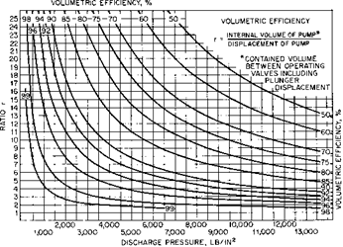
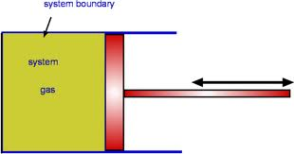
Pump efficiency
Volumetric efficiency :
(Discharge volume / Suction volume)-slip
Mechanical efficiency : loss occurs while overcoming mechanical friction in bearing and speed reduction.
Speed of piston= (stroke)*(rpm)/(30000).
(mm)
The ratio of the power imparted on the fluid by the pump in relation to the power supplied to drive the pump.
60%
50%
90%
Ratio, r
C
S
Discharge Pressure
r = (V_{C}+V_{S})/V_{S} =1+(V_{C}/V_{S})
% of full speed 44 50 73 100
M.E, % 93.3 92.5 92.5 92.5
% of full-load developed pressure | 20 | 40 | 60 | 80 | 100
M.E,% | 82 | 88 | 90 | 92 | 92
Notes:
Slip (S) is the loss of capacity due to internal and external pump leakage.
These include the plungers and packing, the crossheads, the rod seals,
and the bearings. The efficiency of a single acting pump often exceeds 90%, while a doubleacting
piston pump will be 88% due to the additional piston and rod seals. If the pump is
equipped with internal gearing, an additional 2% loss is common.

Slide 13
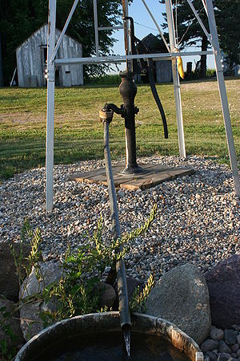
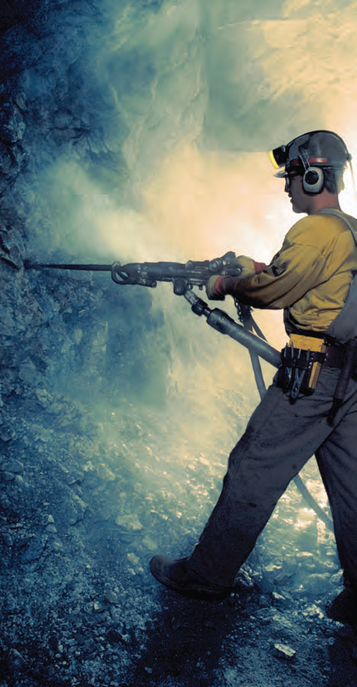
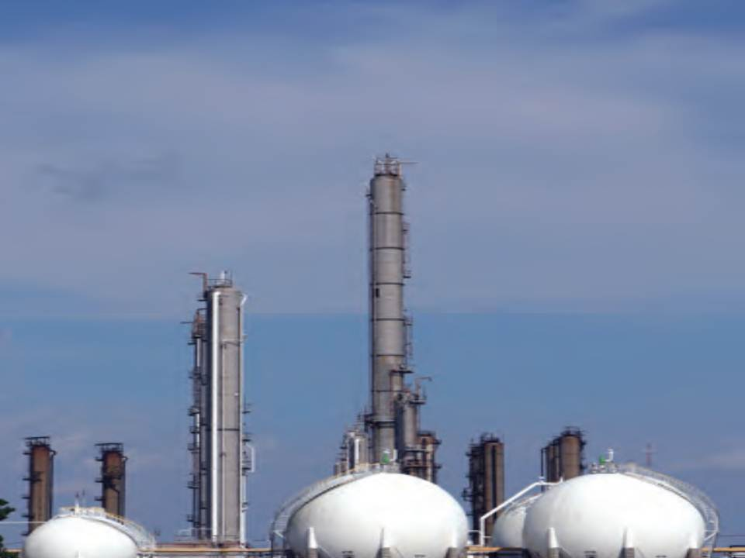
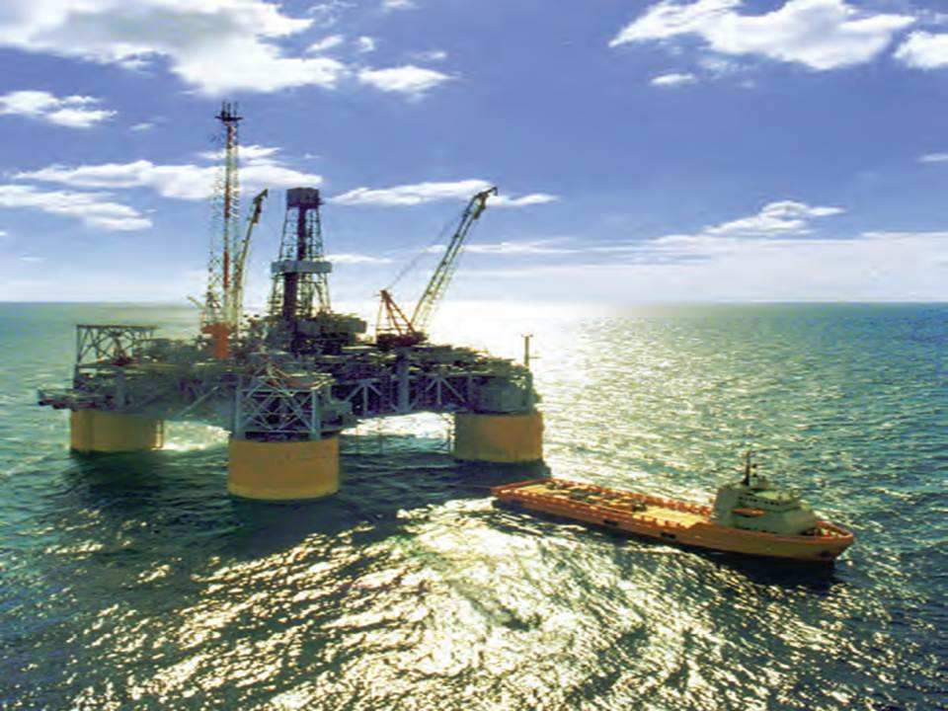
Application
Agriculture.
Chemical.
Desalination.
Horizontal Drilling.
General Industries.
Mining.
Oil and Gas.
Pulp and Paper.
Sewer Cleaning.
Steel.
Notes:
facilitate the removal of cuttings, stabilize the bore hole, cool the cutting head, and lubricate the passage of the product pipe
Markets.
Pumps have two main purposes:
Transfer of liquid from one place to another place (e.g. water from an underground aquifer into a water storage tank)
Circulate liquid around a system (e.g. cooling water or lubricants through machines and equipment)
Reciprocating pumps are used only for pumping viscous liquids and oil wells.

Slide 14
comparison
CENTRIFUGAL( )
RECIPROCATING( )
Loses flow as the viscosity goes up.
Changes in pressure has a dramatic effect on efficiency.
Very inefficient at even modest viscosity.
Increases flow due to thickening of the flow.
Changes in pressure has little effect on efficiency.
Very efficient with high viscosity.
μ
η
P
η
μ
Notes:
higher viscosity liquids fill the clearances of the pump causing a higher volumetric efficiency.
Because the centrifugal pump operates at motor speed, efficiency goes down as viscosity increases due to increased frictional losses within the pump.

